Slide 1

CS 389 – Software Engineering
Lecture 1
Introduction
Adapted from:
Chap 1. Sommerville 9th ed.
Chap 1. Pressman 6th ed.

Slide 2
The Software Product
What is Software?
Software is a set of items or objects that form a "configuration" that includes: Programs, documents, data ...
Who Creates Software? Software Engineers
Why is Software Important? Affects nearly every aspect of life.
How is Software Built? By applying a structured process.
What are the Work Products? Programs, documents, data
Dual Role of Software
Product
Process that delivers products

Slide 3
Software Characteristics
software is engineered
software doesn’t wear out
software is complex
software is like an ‘aging factory’

Slide 4
Software economy
More and more systems are software controlled
The economies of ALL developed nations are dependent on software.
Expenditure on software represents a significant fraction of the GNP in all developed countries.
Gartner Group Reports (2007): $3 Trillion on IT Worldwide (6% of GDP).

Slide 5
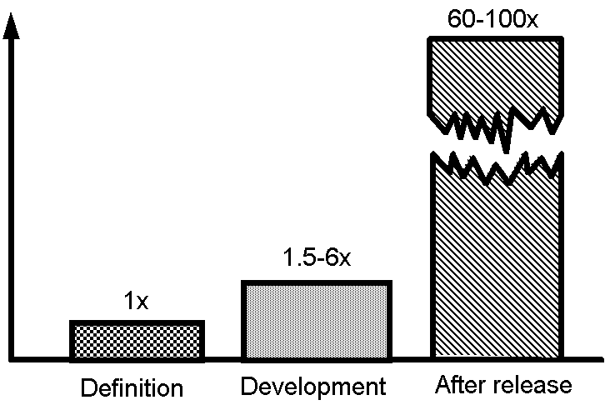
Software costs
Software errors cost the U.S. economy $60 billion annually in rework, lost productivity, and actual damages.
Software costs often dominate computer system costs.
Software costs more to maintain than to develop.
For systems with a long life, maintenance costs may be several times development costs.
The Cost of Change

Slide 6
Software Size
Program/Application | Lines of Code
Solaris | 7,400,000
Netscape | 17 million
Space Station | 40 million
Space Shuttle | 10 million
Boeing 777 | 7 million
Windows 95 | Under 5 million
Linux | 1.5 million

Slide 7
Software Size Categories
Category | Programmers | Duration | Size (Lines of Code)
Extremely Large | > 200 | > 6 years | > 1,000,000
Very Large | 20 - 200 | 3 - 6 years | 100,000 - 1,000,000
Large | 5 - 20 | 2 - 3 years | 20,000 - 100,000
Medium | 2 - 5 | 6 months – 2 years | 3,000 – 20,000
Small | 1 - 2 | 1 - 6 months | 500 - 3,000
Trivial | 1 | 1 - 4 weeks | < 500

Slide 8
Software Disasters (1)
Medical Machine Kills (1985), Cost: Three people dead, three people critically injured
Disaster: Canada’s Therac-25 radiation therapy machine malfunctioned and delivered lethal radiation doses to patients.
Cause: Because of a subtle bug called a race condition, a technician could accidentally configure Therac-25 so the electron beam would fire in high-power mode without the proper patient shielding.
Patriot Fails Soldiers (1991), Cost: 28 soldiers dead, 100 injured
Disaster: During the first Gulf War, an American Patriot Missile system in Saudi Arabia failed to intercept an incoming Iraqi Scud missile. The missile destroyed an American Army barracks.
Cause: A software rounding error incorrectly calculated the time, causing the Patriot system to ignore the incoming Scud missile.

Slide 9
Software Disasters (2)
Ariane Rocket Goes Boom (1996), Cost: $500 million
Disaster: Ariane 5, Europe’s newest unmanned rocket, was intentionally destroyed seconds after launch on its maiden flight. Also destroyed was its cargo of four scientific satellites to study how the Earth’s magnetic field interacts with solar winds.
Cause: Shutdown occurred when the guidance computer tried to convert the sideways rocket velocity from 64-bits to a 16-bit format. The number was too big, and an overflow error resulted. When the guidance system shut down, control passed to an identical redundant unit, which also failed because it was running the same algorithm.
Mars Climate Crasher (1998), Cost: $125 million
Disaster: After a 286-day journey from Earth, the Mars Climate Orbiter fired its engines to push into orbit around Mars. The engines fired, but the spacecraft fell too far into the planet’s atmosphere, likely causing it to crash on Mars.
Cause: The software that controlled the Orbiter thrusters used imperial units (pounds of force), rather than metric units (Newtons) as specified by NASA.

Slide 10
So What Does All This Mean?
Seat of your pants programming will not work!
Urgent need for techniques that can be used to manage the development of large software systems
This is part of what software engineering is all about

Slide 11
Frequently asked questions about software engineering
Question | Answer
What is software? | Computer programs and associated documentation. Software products may be developed for a particular customer or may be developed for a general market.
What are the attributes of good software? | Good software should deliver the required functionality and performance to the user and should be maintainable, dependable and usable.
What is software engineering? | Software engineering is an engineering discipline that is concerned with all aspects of software production.
What are the fundamental software engineering activities? | Software specification, software development, software validation and software evolution.
What is the difference between software engineering and computer science? | Computer science focuses on theory and fundamentals; software engineering is concerned with the practicalities of developing and delivering useful software.
What is the difference between software engineering and system engineering? | System engineering is concerned with all aspects of computer-based systems development including hardware, software and process engineering. Software engineering is part of this more general process.

Slide 12
Frequently asked questions about software engineering
Question | Answer
What are the key challenges facing software engineering? | Coping with increasing diversity, demands for reduced delivery times and developing trustworthy software.
What are the costs of software engineering? | Roughly 60% of software costs are development costs, 40% are testing costs. For custom software, evolution costs often exceed development costs.
What are the best software engineering techniques and methods? | While all software projects have to be professionally managed and developed, different techniques are appropriate for different types of system. For example, games should always be developed using a series of prototypes whereas safety critical control systems require a complete and analyzable specification to be developed. You can’t, therefore, say that one method is better than another.
What differences has the web made to software engineering? | The web has led to the availability of software services and the possibility of developing highly distributed service-based systems. Web-based systems development has led to important advances in programming languages and software reuse.

Slide 13
Essential attributes of good software
Product characteristic | Description
Maintainability | Software should be written in such a way so that it can evolve to meet the changing needs of customers. This is a critical attribute because software change is an inevitable requirement of a changing business environment.
Dependability and security | Software dependability includes a range of characteristics including reliability, security and safety. Dependable software should not cause physical or economic damage in the event of system failure. Malicious users should not be able to access or damage the system.
Efficiency | Software should not make wasteful use of system resources such as memory and processor cycles. Efficiency therefore includes responsiveness, processing time, memory utilisation, etc.
Acceptability | Software must be acceptable to the type of users for which it is designed. This means that it must be understandable, usable and compatible with other systems that they use.

Slide 14
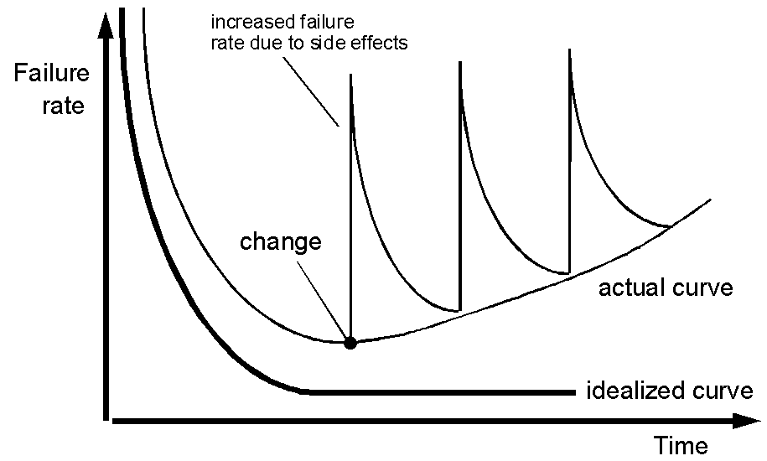
Questions Asked of Software Engineers
Why does it take so long to finish software?
Why are development costs so high?
Why can’t we find all the bugs before delivery?
Why do we continue to have difficulties measuring progress in the software development process?

Slide 15
Software engineering
Software Engineering Definition:
The establishment and use of sound engineering principles in order to economically obtain software that is reliable and works efficiently on real machines.
(1) The application of a systematic, disciplined, quantifiable approach to the development, operation, and maintenance of software; that is, the application of engineering to software.
(2) The study of approaches, as in (1).

Slide 16
Importance of software engineering
Individuals and society rely on advanced software systems.
We need to be able to produce reliable and trustworthy systems economically and quickly.
It is usually cheaper to use software engineering methods and techniques for software systems rather than just write the programs as if it was a personal programming project.
For most types of system, the majority of costs are the costs of changing the software after it has gone into use.

Slide 17
Software process activities
Software specification, where customers and engineers define the software that is to be produced and the constraints on its operation.
Software development, where the software is designed and programmed.
Software validation, where the software is checked to ensure that it is what the customer requires.
Software evolution, where the software is modified to reflect changing customer and market requirements.

Slide 18
General issues that affect most software
Heterogeneity
Increasingly, systems are required to operate as distributed systems across networks that include different types of computer and mobile devices.
Business and social change
Business and society are changing incredibly quickly as emerging economies develop and new technologies become available. They need to be able to change their existing software and to rapidly develop new software.
Security and trust
As software is intertwined with all aspects of our lives, it is essential that we can trust that software.

Slide 19
Software engineering diversity
There are many different types of software systems and there is no universal set of software techniques that is applicable to all of these.
The software engineering methods and tools used depend on the type of application being developed, the requirements of the customer and the background of the development team.

Slide 20
Software Applications
system software
real-time software
business software
engineering/scientific software
embedded software
PC software
mobile software
games and simulations
WebApps (Web applications)

Slide 21
Software engineering fundamentals
Some fundamental principles apply to all types of software system, irrespective of the development techniques used:
Systems should be developed using a managed and understood development process.
Dependability and performance are important for all types of system.
Understanding and managing the software specification and requirements (what the software should do) are important.
Where appropriate, you should reuse software that has already been developed rather than write new software.

Slide 22
Software engineering and the web
The Web is now a platform for running application and organizations are increasingly developing web-based systems rather than local systems.
Web services allow application functionality to be accessed over the web.
Web-based systems are complex distributed systems, but the fundamental principles of software engineering are as applicable to them as they are to any other types of systems.

Slide 23
Web software engineering
Software reuse is the dominant approach for constructing web-based systems.
When building these systems, you think about how you can assemble them from pre-existing software components and systems.
Web-based systems should be developed and delivered incrementally.
It is now generally recognized that it is impractical to specify all the requirements for such systems in advance.
User interfaces are constrained by the capabilities of web browsers.
Technologies such as AJAX allow rich interfaces to be created within a web browser but are still difficult to use. Web forms with local scripting are more commonly used.

Slide 24
Key points
Software engineering is an engineering discipline that is concerned with all aspects of software production.
Essential software product attributes are maintainability, dependability and security, efficiency and acceptability.
The high-level activities of specification, development, validation and evolution are part of all software processes.
The fundamental notions of software engineering are universally applicable to all types of system development.

Slide 25
Key points
There are many different types of system and each requires appropriate software engineering tools and techniques for their development.
The fundamental ideas of software engineering are applicable to all types of software system.

